Slide 1
The Oslo Method (Part I)
Energy
Fission
Bn ≈ 5 MeV
Simultaneously extraction of:
nuclear level density (NLD)
γ-ray strength function (γSF)
Quasi-continuum
Millions of states/MeV
Magne Guttormsen
Department of Physics
University of Oslo
Spin

Slide 2
Outline
Motivation
What is nuclear level density and γ-ray strength functions
Typical experimental set-up
Components of the Oslo method

Slide 3
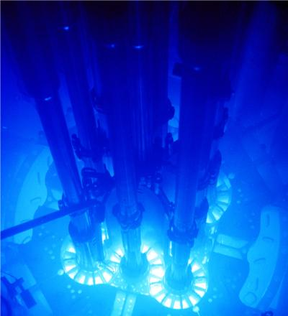
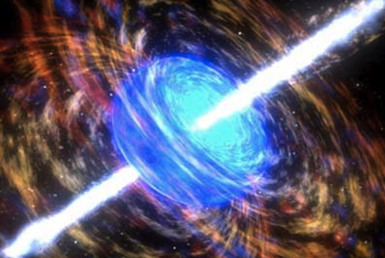
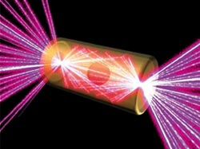
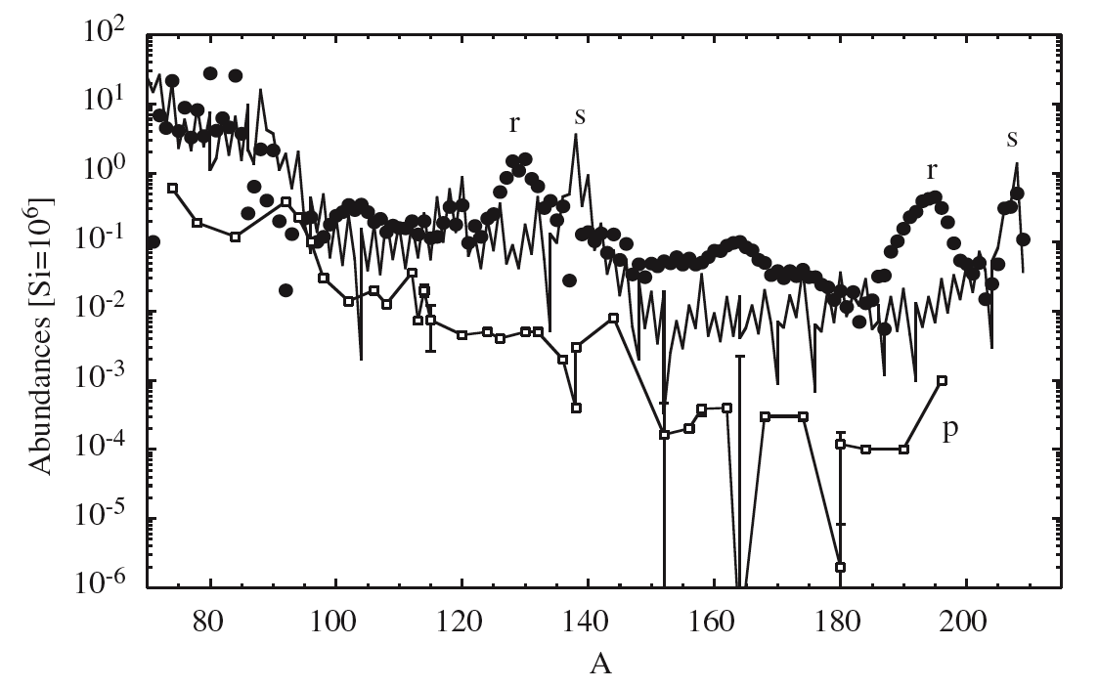
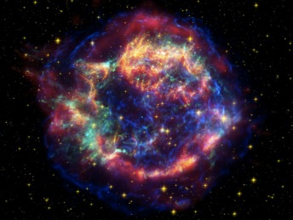
Motivation
Fundamental nuclear structures and dynamics
Enables cross-section calculations via the Hauser-Feshbach formalism (“compound nucleus” picture)
Astrophysics: nucleosynthesis of heavy elements
Reactor physics: prediction of unknown cross sections for next-generation reactors… ++

Slide 4
Nuclear regimes

Slide 5
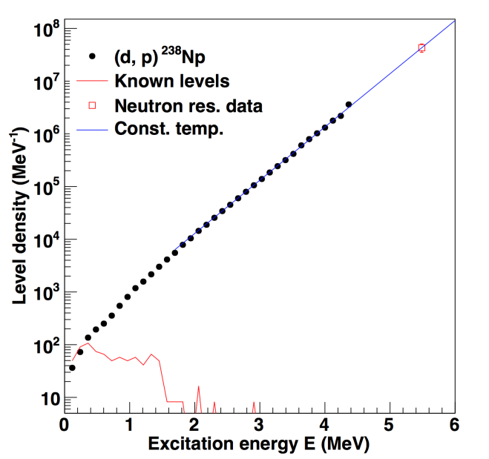
The probe: γ-rays

Slide 6
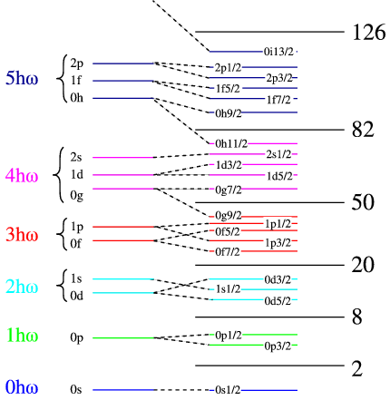
Level density
Number of nuclear energy levels per energy unit (MeV⁻¹) as a function of excitation energy
Information about structural changes in the nucleus (breaking of nucleon Cooper pairs, shell structure, temperature, … )
Cooper pair Broken pair
25 = 5*5

Slide 7
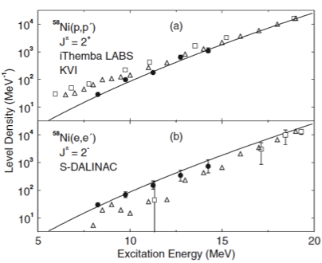
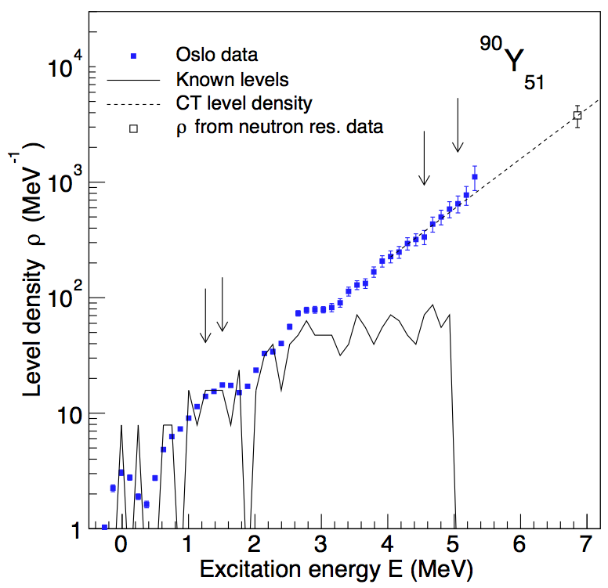
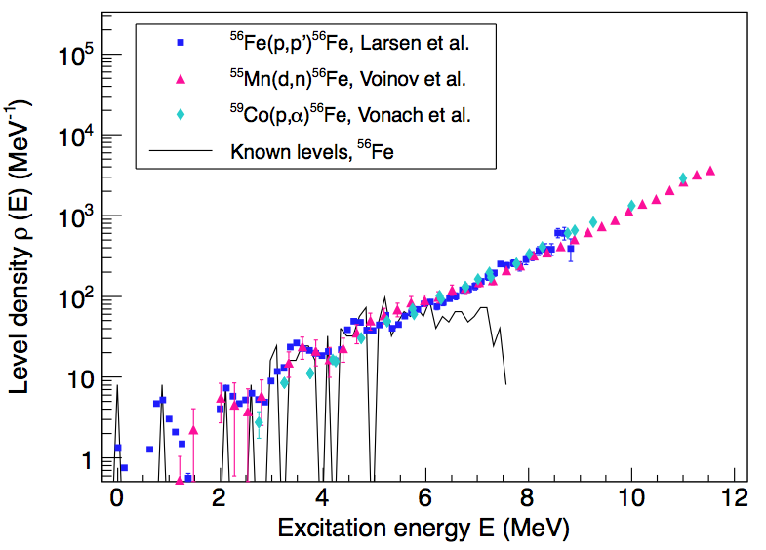
Techniques to measure level density
Discrete levels (Ex < 2 - 3 MeV or < 50 - 100 levels/MeV)
Neutron/proton resonances (Ex = Sn or Sp)
Particle evaporation spectra (Ex = 4 - 15 MeV)
Spin/parity resolved level densities from (p,p´) or (e,e´)
Ericson fluctuations (Ex ~ 15 MeV)
Primary γ spectra with the Oslo method (Ex < Sn)
Kalmykov et al.,
PRL 99,
202502 (2007)
A.C. Larsen et al.,
PRL 111,
242504 (2013)
M. Guttormsen et al.,
PRC, (2014), in press

Slide 8
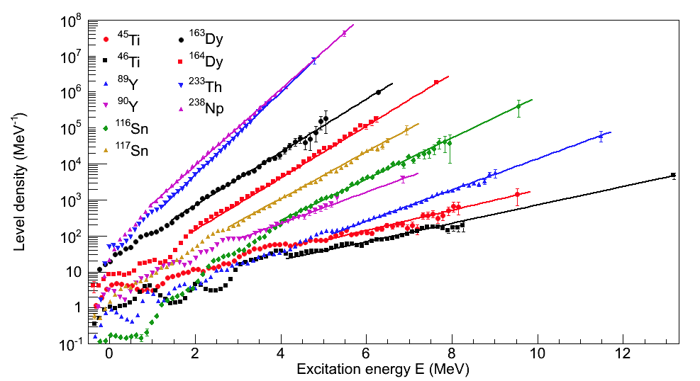
Level densities using the Oslo method

Slide 9
Gamma-ray strength function
A measure on the average, nuclear electromagnetic response, directly related to reduced transition probabilities B(XL) and γ-transmission coefficients
Fruitful concept in the quasi-continuum/continuum region (high level density)
Normally dominated by the tail of the Giant (Electric) Dipole Resonance
E_{x}
γ
protons
neutrons
g.s.

Slide 10
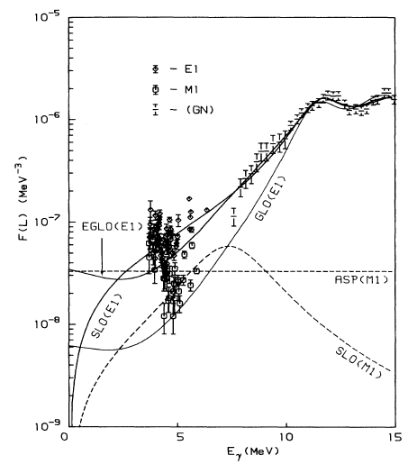
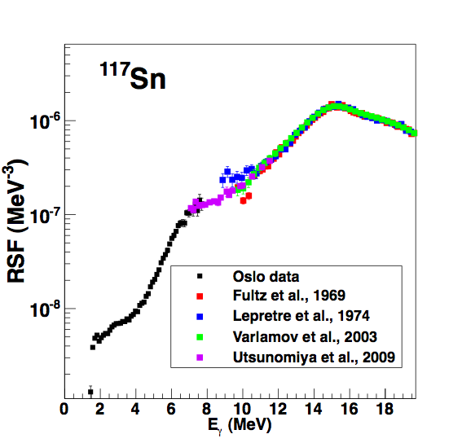
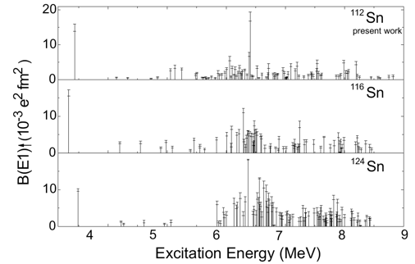
Techniques to measure γSF
Photonuclear reactions (above S_{n})
Primary transitions following n-capture (around S_{n})
(γ,γ’), (e,e’), (p,p’), ... (below S_{n})
Two-step cascade spectra following n/p capture (below S_{n})
Primary γ spectra (Oslo method, below S_{n})
[Ôzel et al., NP A788, 385c (2007);
Govaert et al, PRC 57, 2229 (1998)]
[Kopecky et al, PRC 47, 312 (1993)]
[Utsunomiya et al., PRC 80, 055806 (2009);
Agvaanluvsan et al, PRL 102, 162504 (2009)]
10

Slide 11
Discrete Quasi-continuum
Number of levels per MeV
Nuclear entropy
Nuclear temperature and heat capacity
NUCLEAR LEVEL DENSITY (NLD)
ρ(Ex)
Ex I^{π}
ΔE
Average, nuclear electromagnetic response
Independent on the number of levels
i
ΔE
i
γ-RAY STRENGTH FUNCTION (γSF)
B(XL)
f_{XL}(Eγ)
f
ΔE
f

Slide 12
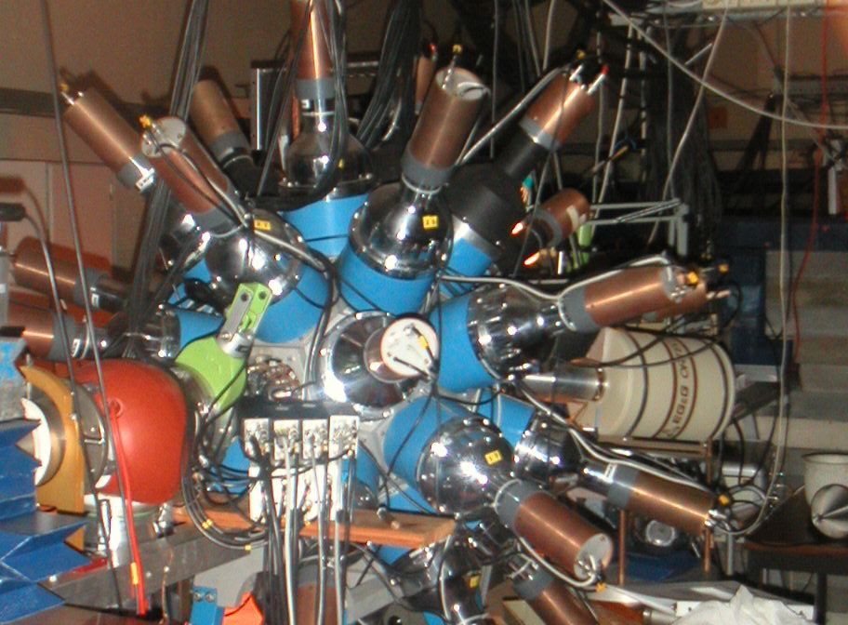
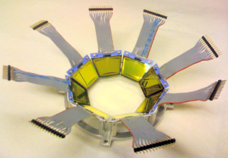
Th and U experiments @ OCL
12 MeV d on ²³²Th
24 MeV ³He on ²³²Th
15 MeV d on ²³⁸U
Backwards:
ϑ = 126º – 140º
5”x5” NaI
γ
³He –beam
³He, α,d,t
∆E-E
^{M.Guttormsen,} A.Bürger, T.E.Hansen, N.Lietaer,
^{NIM A648(2011)168}

Slide 13
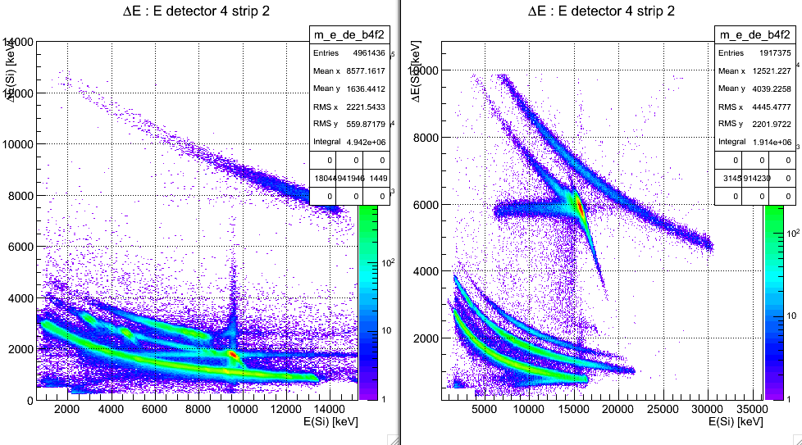
∆E-E bananas
(³He,α)²³¹Th
(d,d’)²³²Th (d,p)²³³Th
(³He,t)²³²Pa (³He,d)²³³Pa

Slide 14
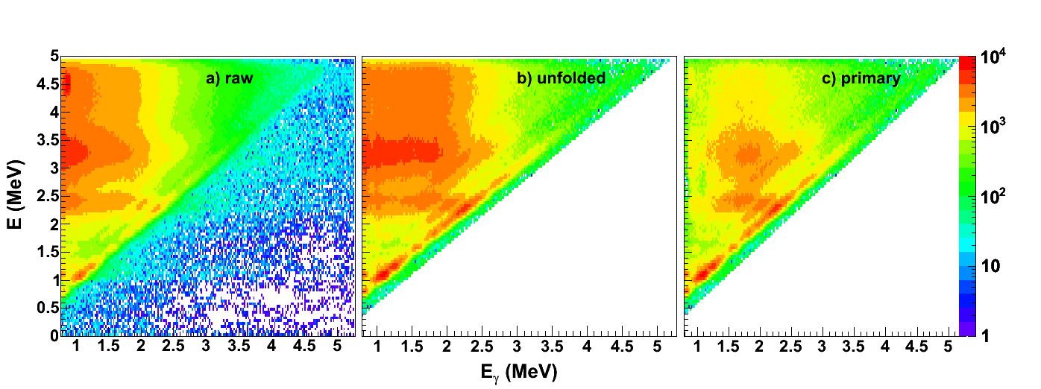
Raw – Unfolded - Primary
²³²Th(d,p)²³³Th
P(E,E_{γ})
Oslo method:
M. Guttormsen et al., NIM A374 (1996) 371
M. Guttormsen et al., NIM A255 (1987) 518
Schiller et al., NIM A447 (2000) 498
A.C. Larsen et al., Phys. Rev. C 83, 034315 (2011)

Slide 15
Assumption for the extraction of first-generation γ-spectra
(d,p)
γ
E
(d,p)
The γ-energy distribution is the same
if the decay starts at E after γ-emission or
starts after the direct reaction into E.

Slide 16
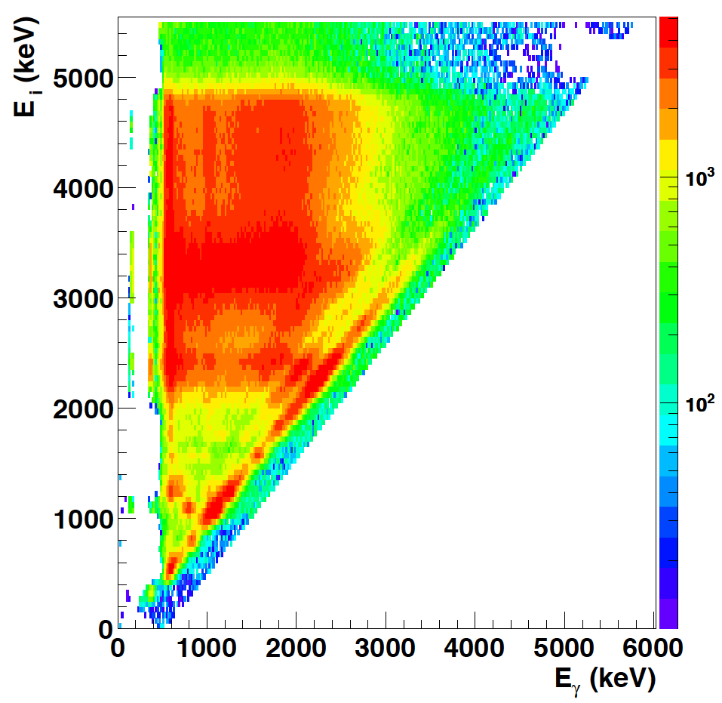
From total to primary matrix
²³²Th(d,p) ²³³Th

Slide 17
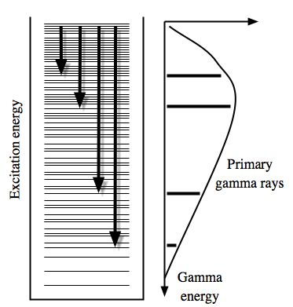
Multiplicative factors
Fermi’s golden rule
Brink hypothesis

Slide 18
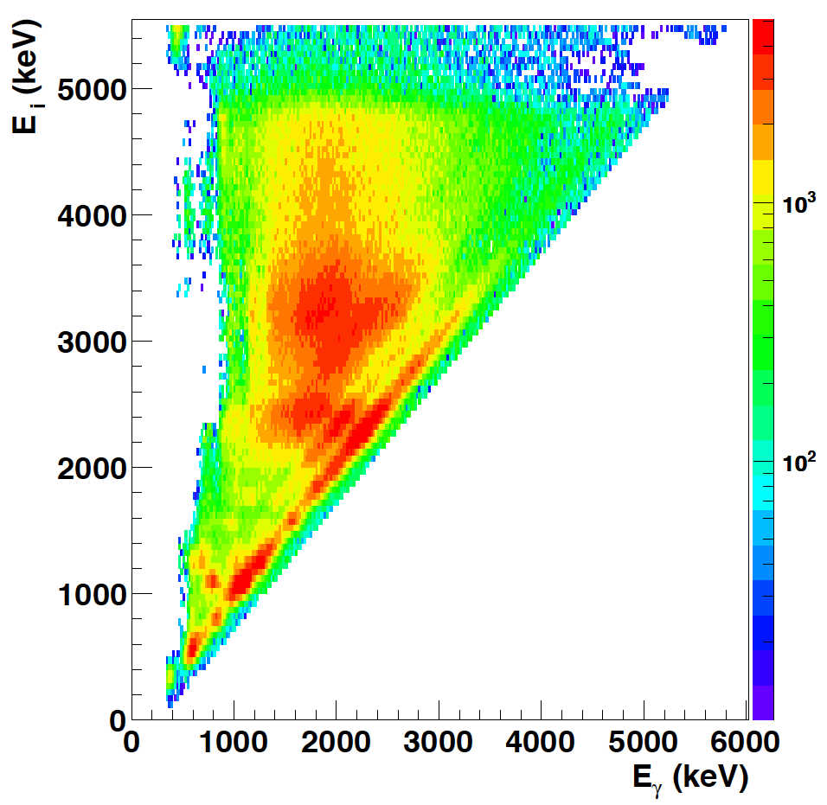
Select an E_{x} – E_{γ} region
P(E_{x},E_{γ})
Level density Trans. coeff.
ρ(E_{f}) T(E_{γ})
Fermi’s golden rule Brink hypothesis
P(E_{x},E_{γ})

Slide 19
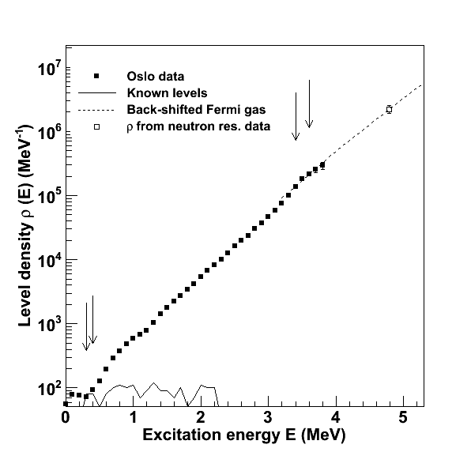
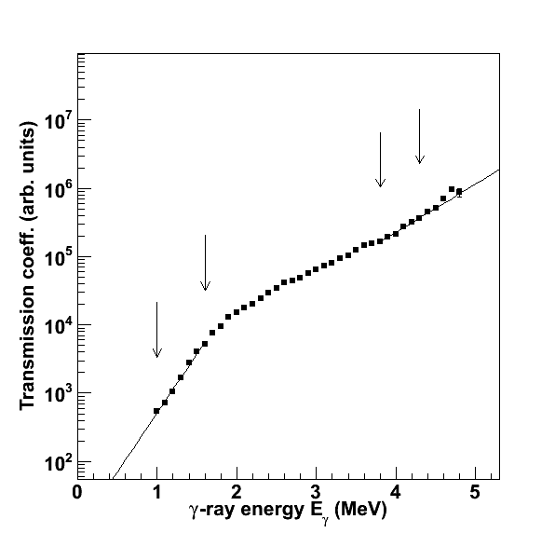
ρ(E_{f}) and T(E_{γ})

Slide 20
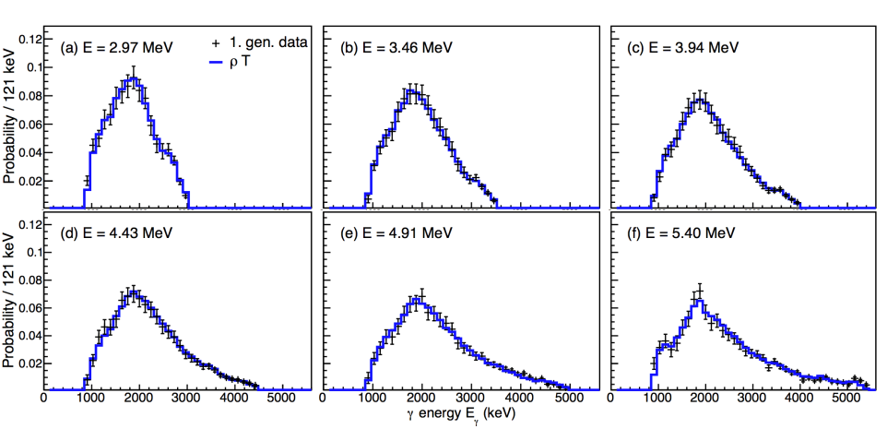
P(E,E_{γ}) = ρ(E_{f})T(E_{γ})?

Slide 21
Summary (Part I)
Simultaneous extraction of level density
and γ-ray strength function
NLD normalized to known levels and ρ(S_{n}) from D₀
γSF normalized to < Γ_{γ} (S_{n}) >

Slide 22

Thank you !
Mr. Osbome, may I be excused? My brain is full.

